Slide 1
using the ethz computer cluster
Lab meeting 21/09/2020
Bernat Bramon Mora
ETH Zürich
Plant Ecology group

Slide 2
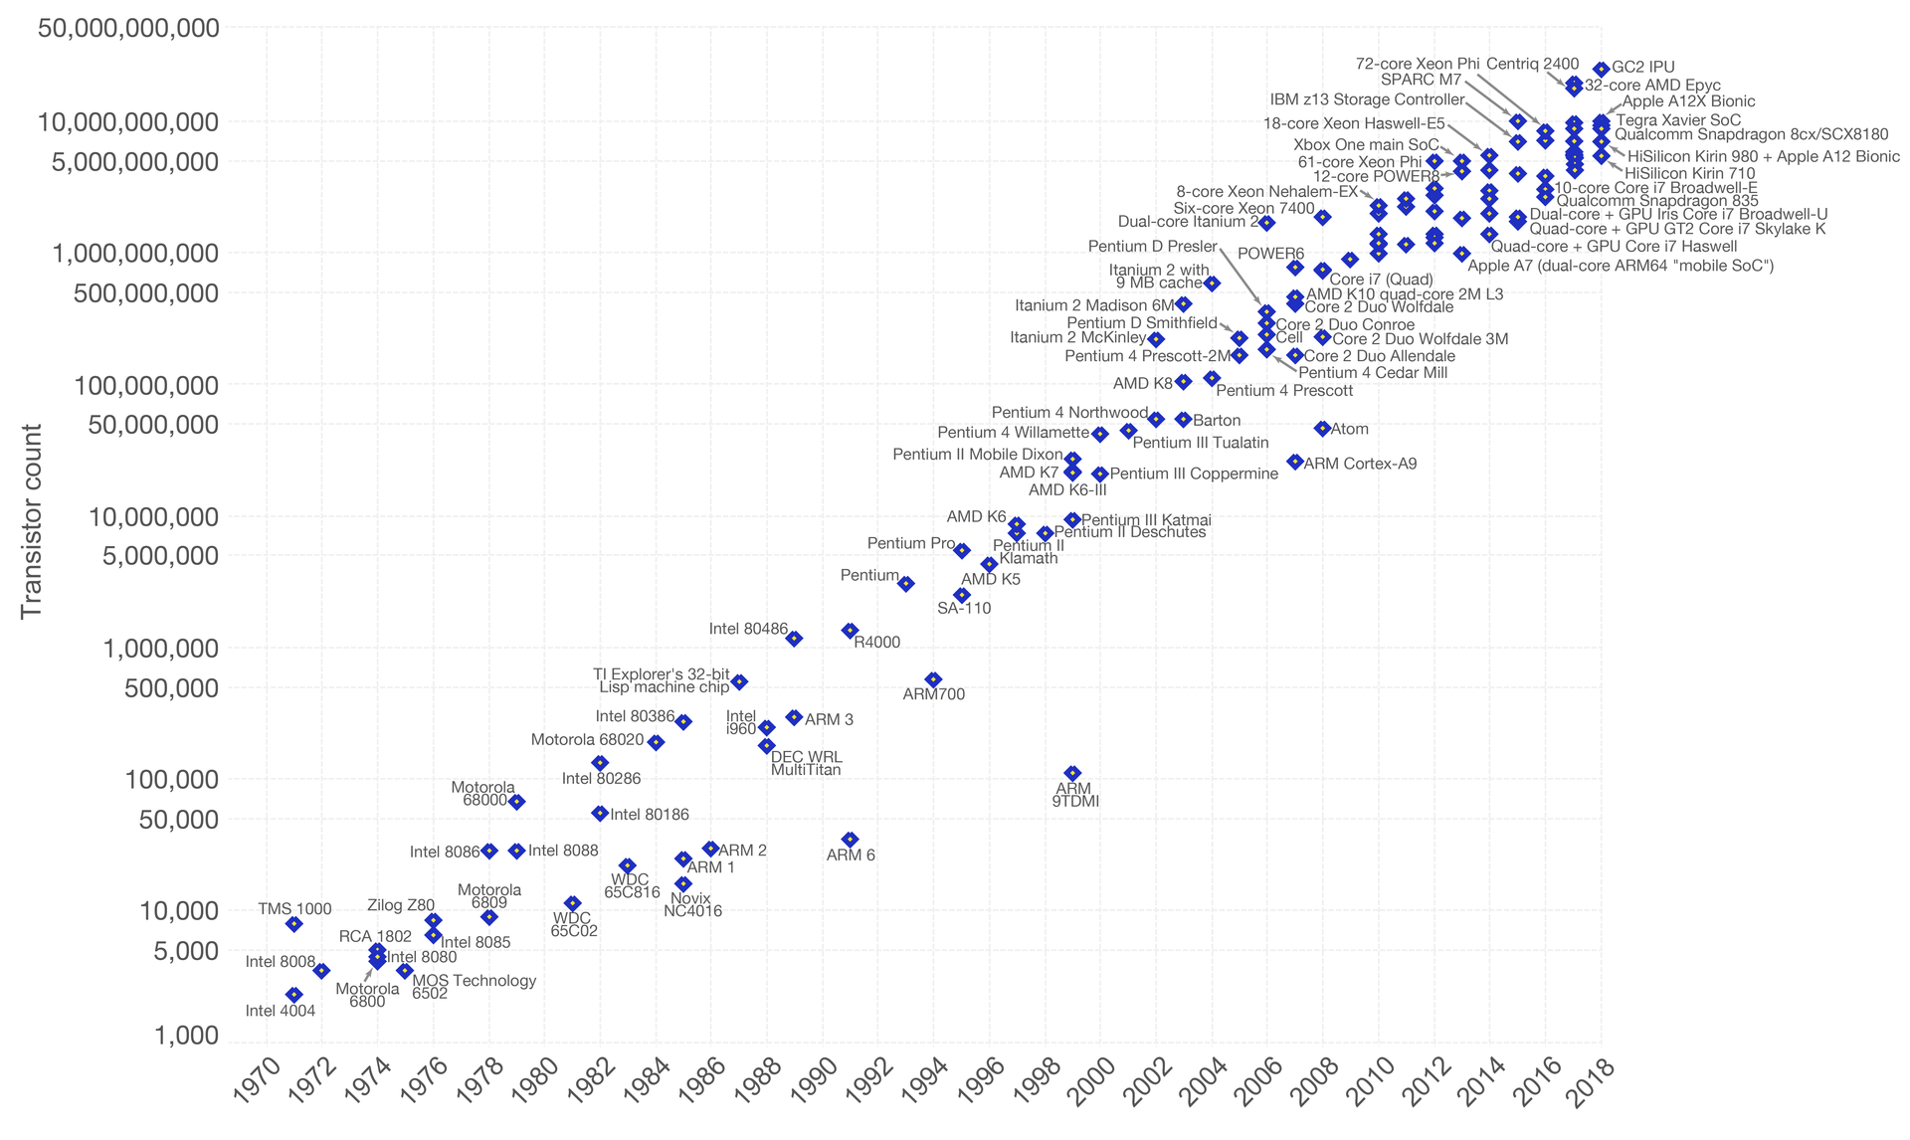

Slide 3

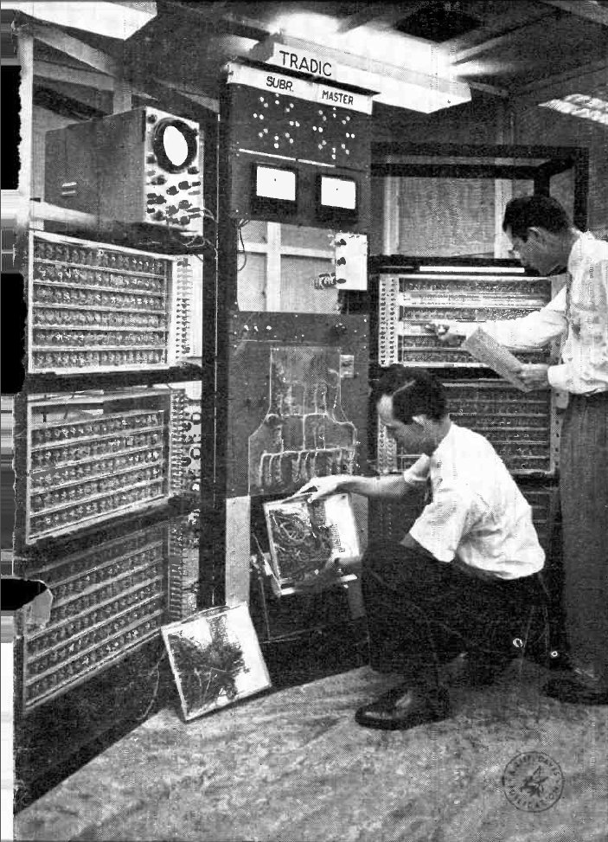
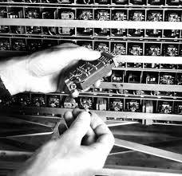
~14 nanometers
1954
~800 transistors

Slide 4
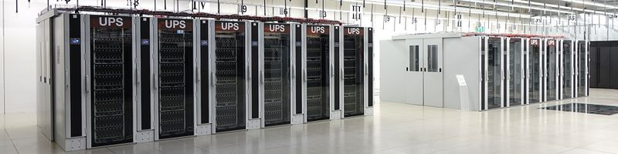
What is a computer cluster?

Slide 5
What is a computer cluster?
… it’s really just a set of computers connected together

Slide 6
computer 1
computer 2
computer 3
computer 4
computer 5
computer 6
computer 7
computer 8
computer 9

Slide 7
computer 1
computer 2
computer 3
computer 4
computer 5
computer 6
computer 7
computer 8
computer 9

Slide 8
computer 1
computer 2
computer 3
computer 4
computer 5
computer 6
computer 7
computer 8
head node

Slide 9
computer 1
computer 2
computer 3
computer 4
computer 5
computer 6
computer 7
computer 8
head node
Internet

Slide 10
computer 1
computer 2
computer 3
computer 4
storage 1
computer 5
computer 6
computer 7
storage 2
computer 8
head node
Internet

Slide 11

computer 1
computer 2
computer 3
computer 4
storage 1
computer 5
computer 6
computer 7
storage 2
computer 8
head node
Internet
dumb-script.R

Slide 12
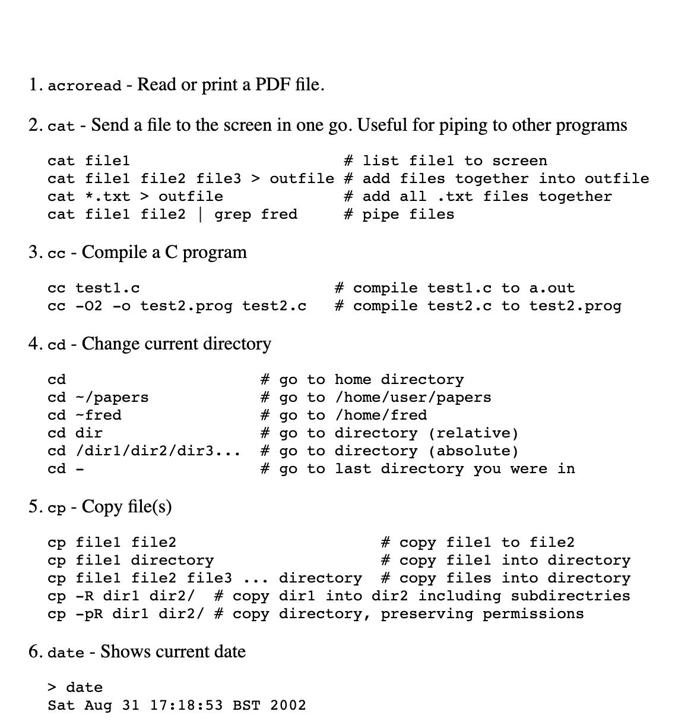
Basic Shell Commands
computer 1
computer 2
computer 3
computer 4
storage 1
computer 5
computer 6
computer 7
storage 2
computer 8
head node
Internet
. . .
dumb-script.R

Slide 13
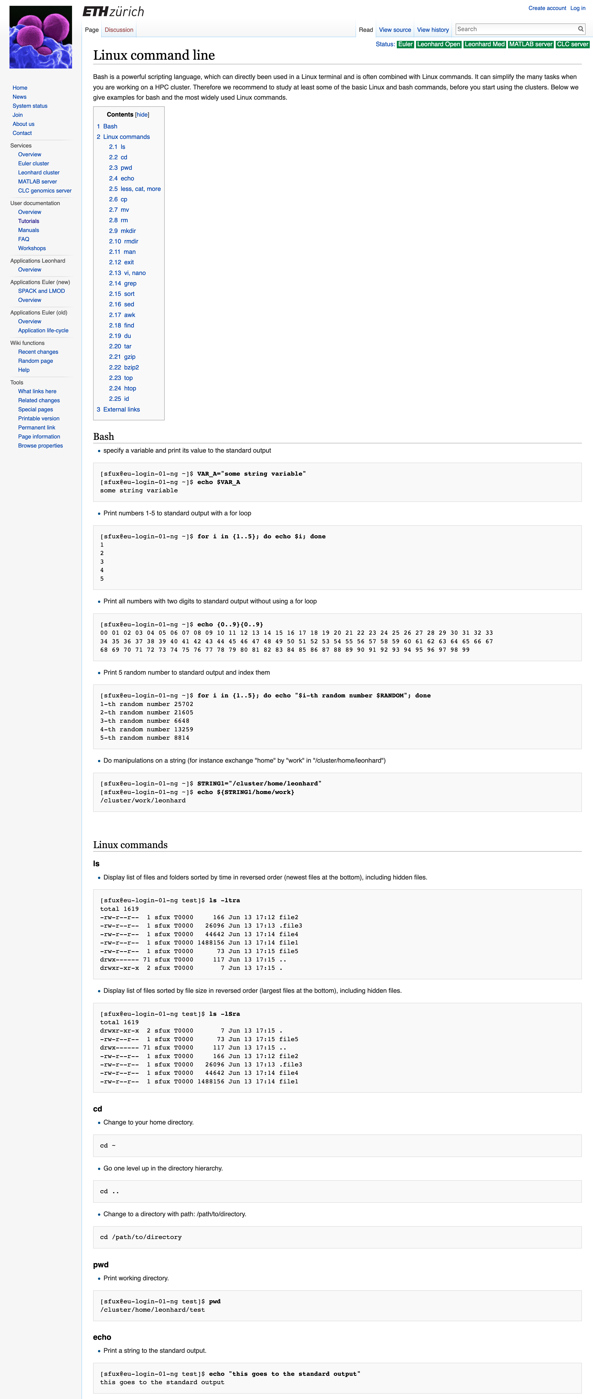

Slide 14
computer 1
computer 2
computer 3
computer 4
storage 1
computer 5
computer 6
computer 7
storage 2
computer 8
head node
Internet
dumb-script.R

Slide 15





computer 1
computer 2
computer 3
computer 4
storage 1
computer 5
computer 6
computer 7
storage 2
computer 8
head node
Internet
dumb-script.R
herbivory.R
competition.py
ranges.jl
fagus-sylvatica.cpp
eco-evo.sh

Slide 16
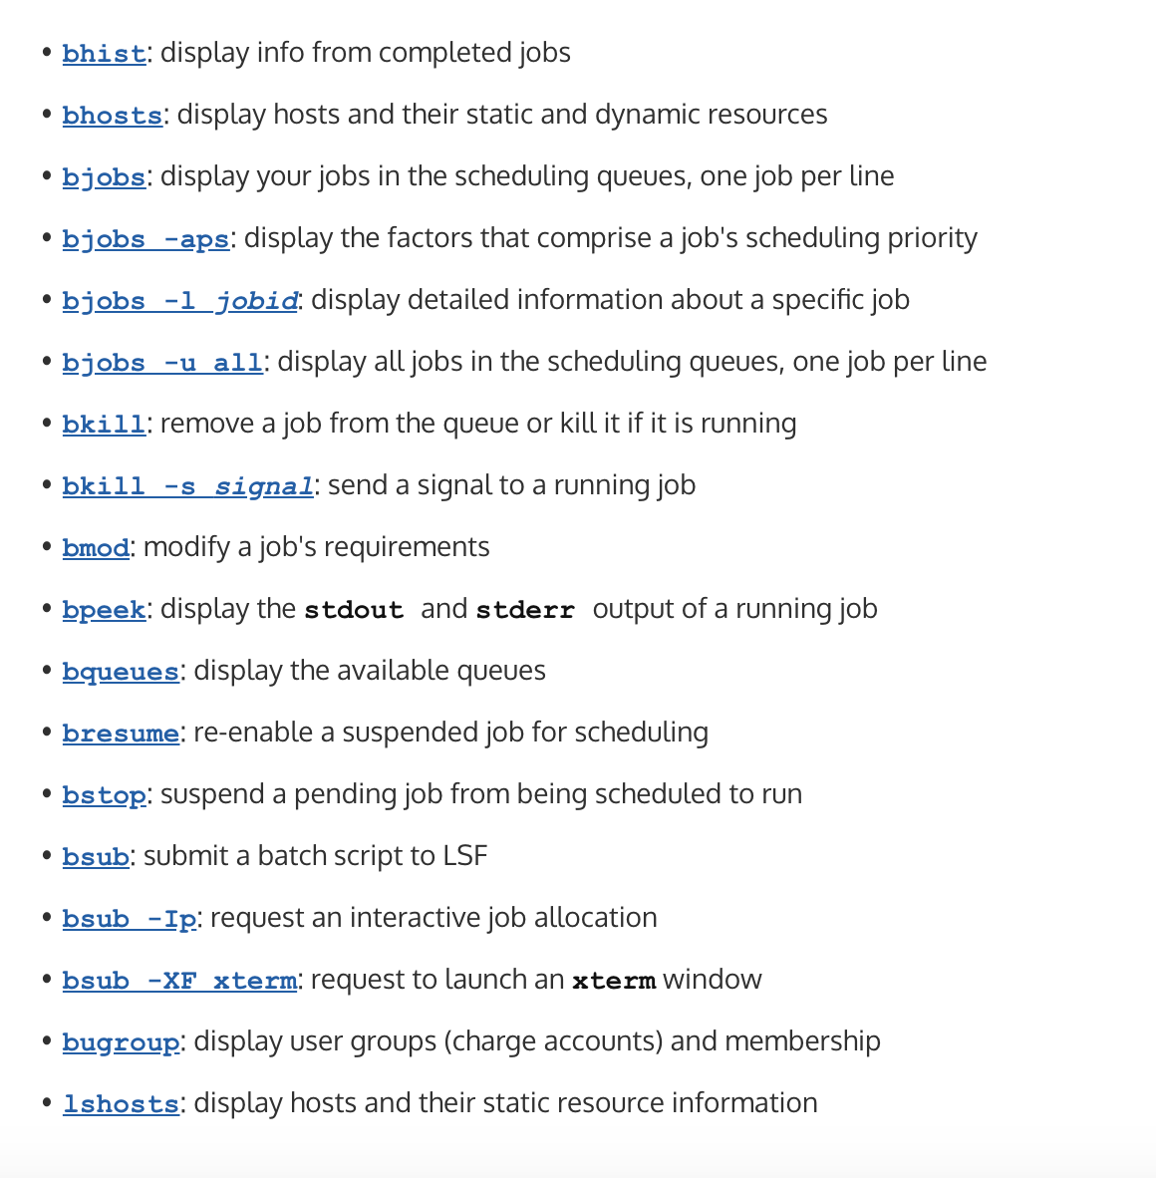
Using the Euler’s batch system
computer 1
computer 2
computer 3
computer 4
storage 1
computer 5
computer 6
computer 7
storage 2
computer 8
head node
Internet

Slide 17
Using the Euler’s batch system
computer 1
computer 2
computer 3
computer 4
storage 1
computer 5
computer 6
computer 7
storage 2
computer 8
head node
Internet

Slide 18
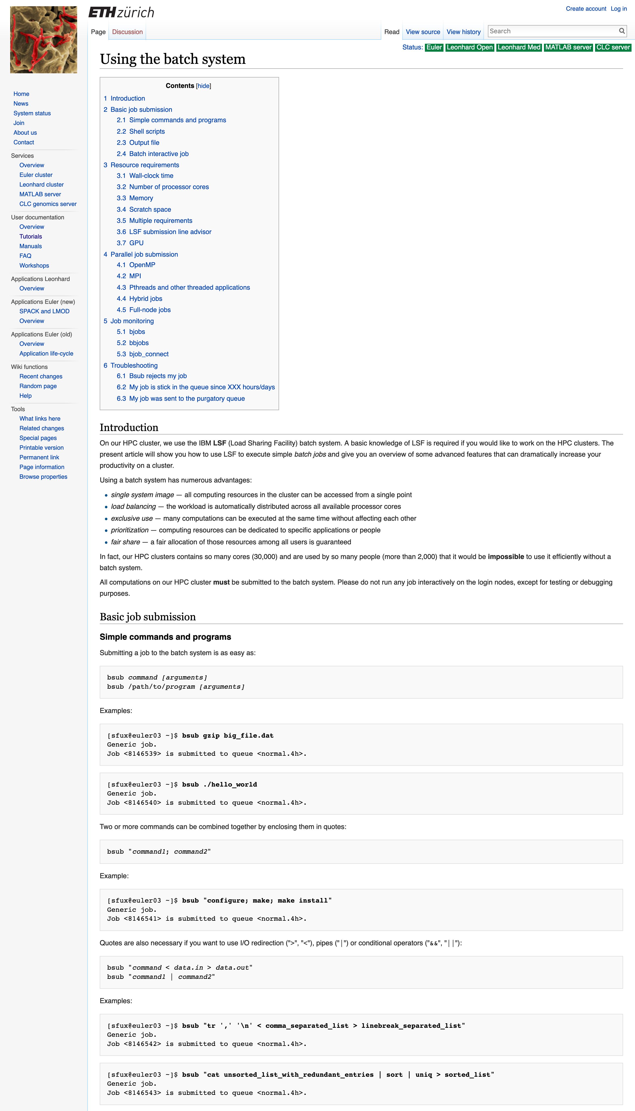

Slide 19
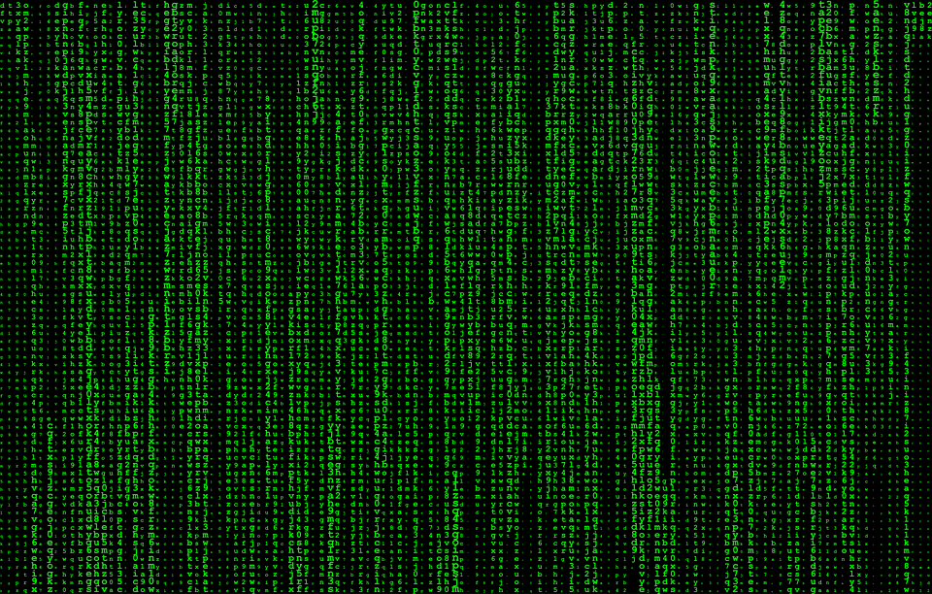

Slide 20
Shell commands
ls
cd
ssh
scp
vim
Batch commands
bsub
bjobs
bkill

Slide 21
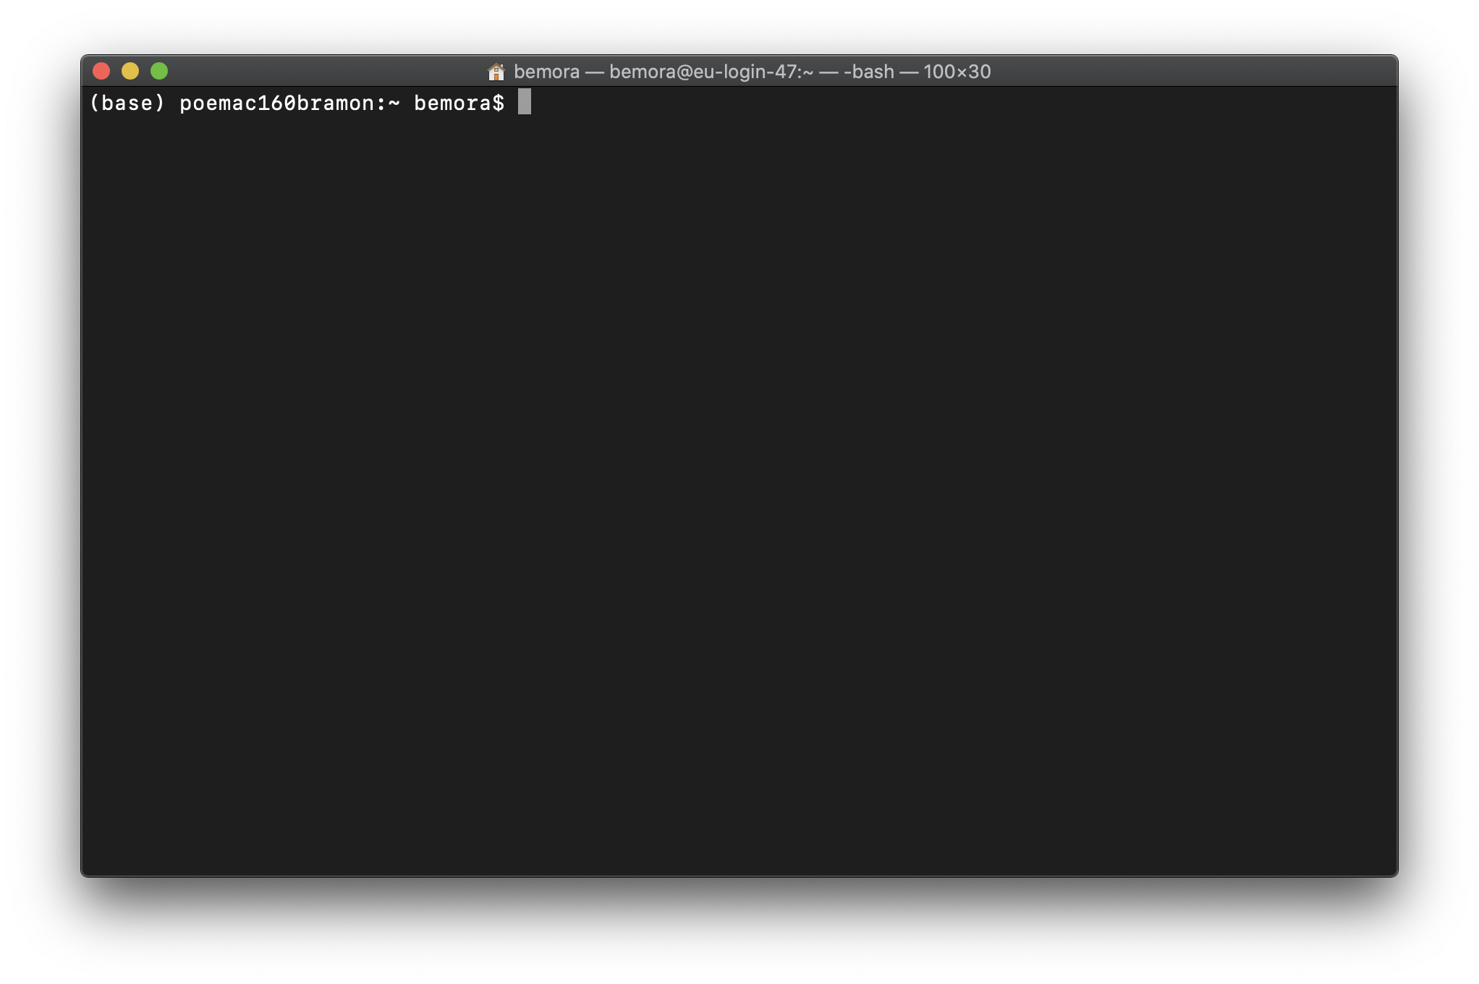
ssh

Slide 22
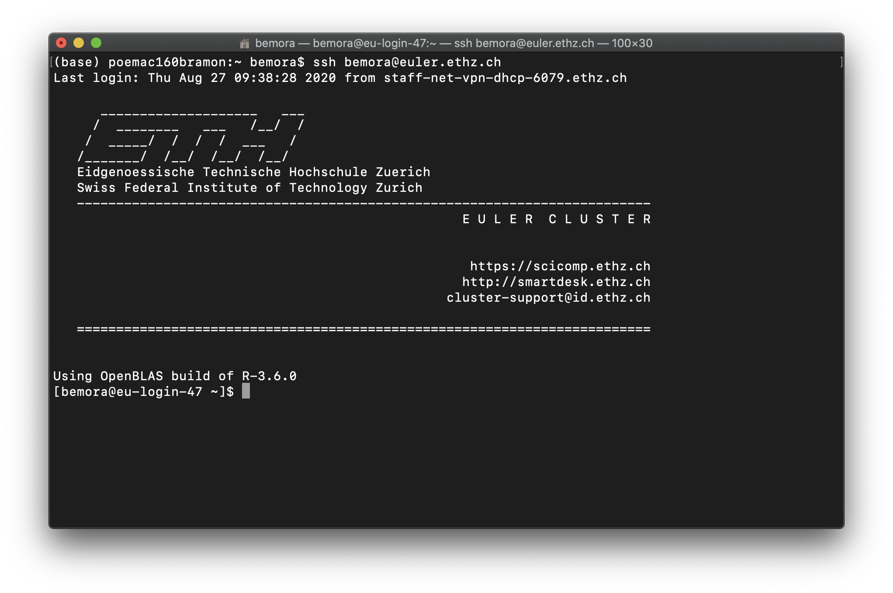
ssh

Slide 23
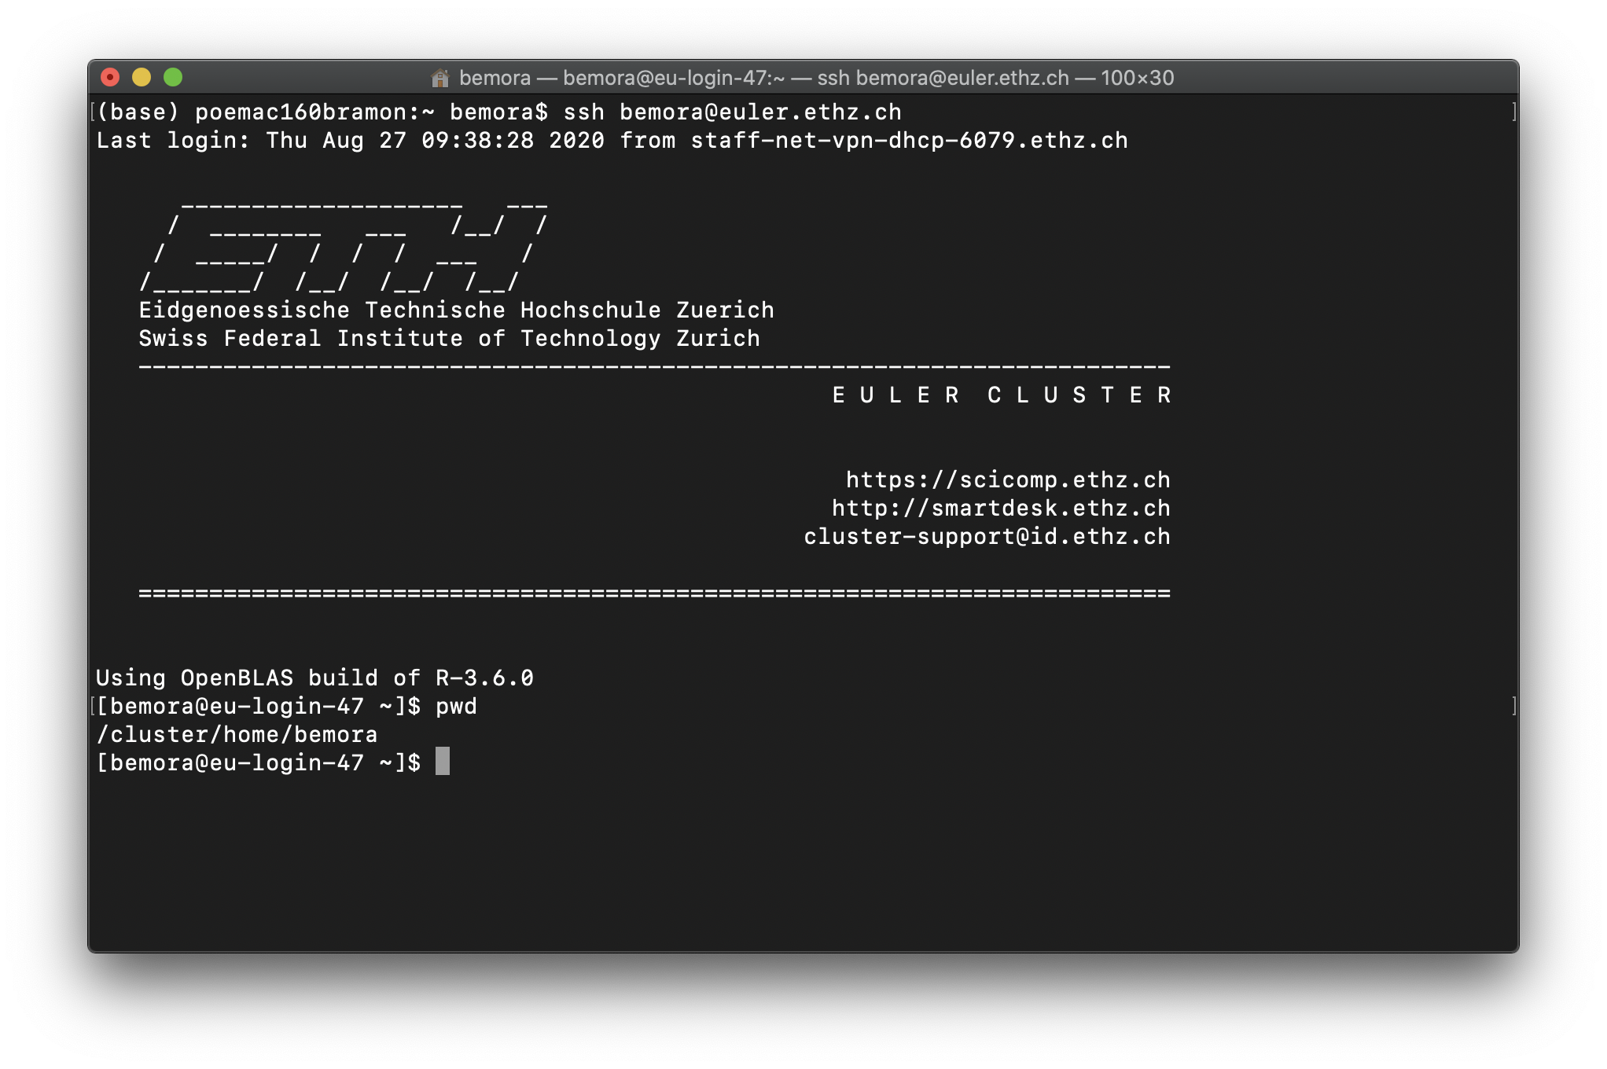
ssh

Slide 24
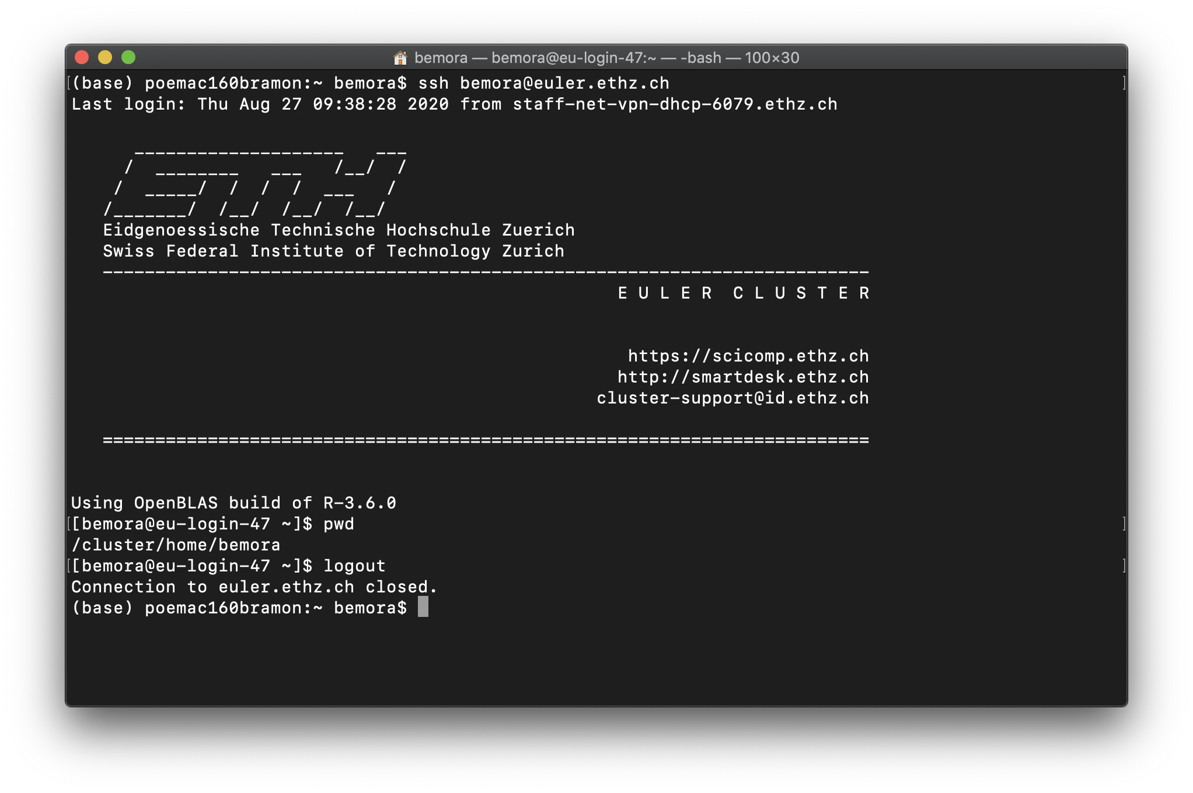
ssh

Slide 25
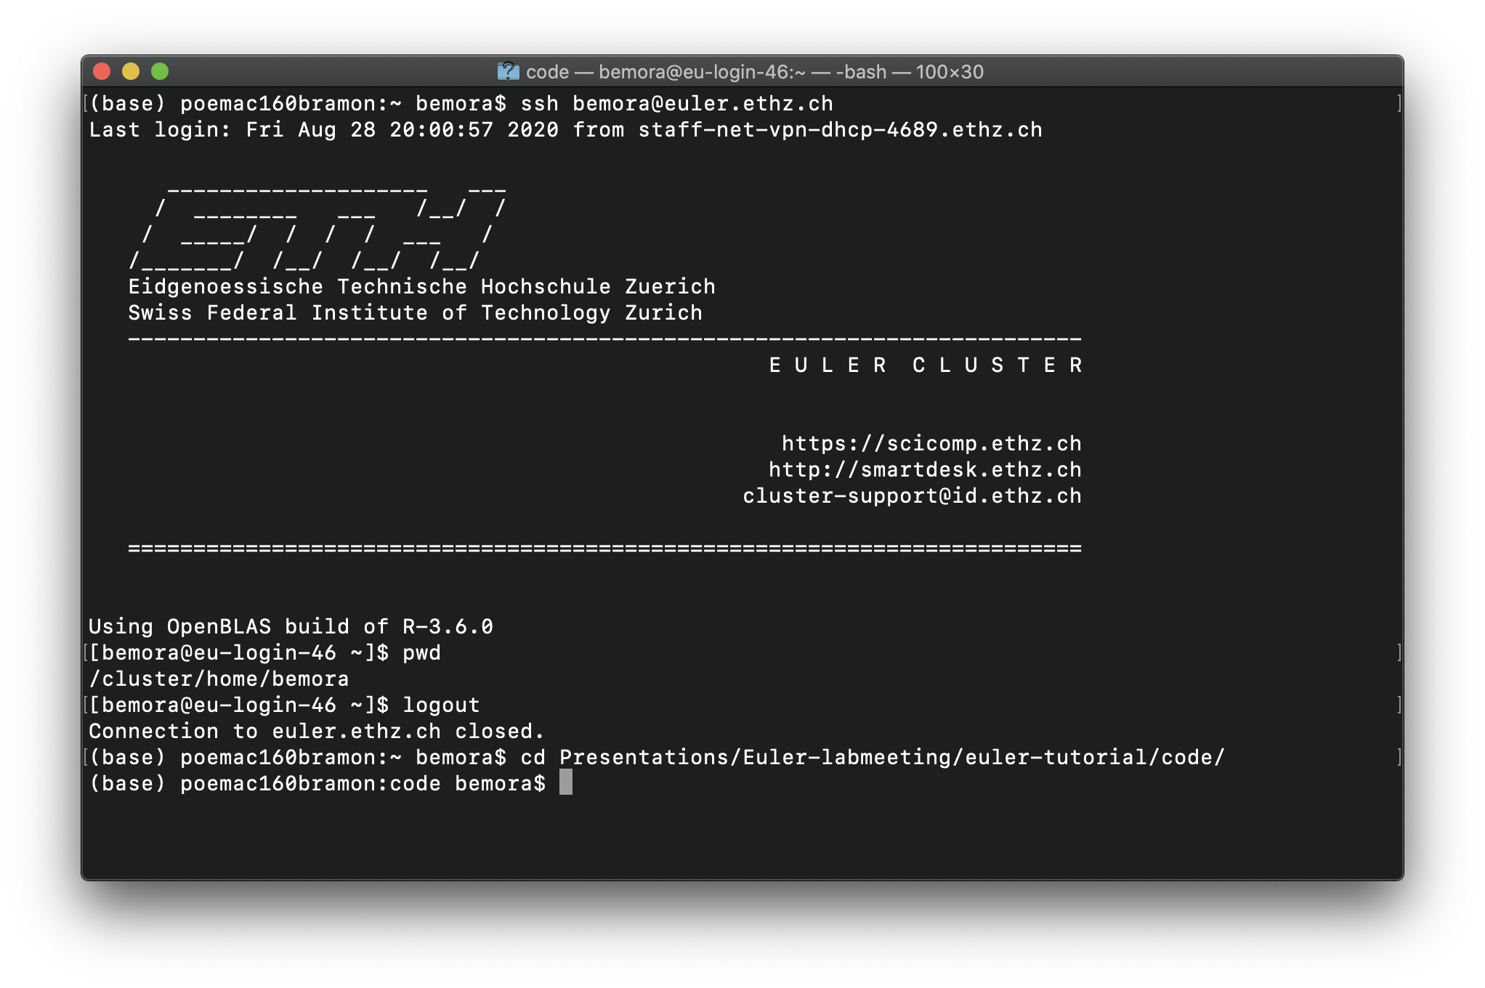
find your script…

Slide 26
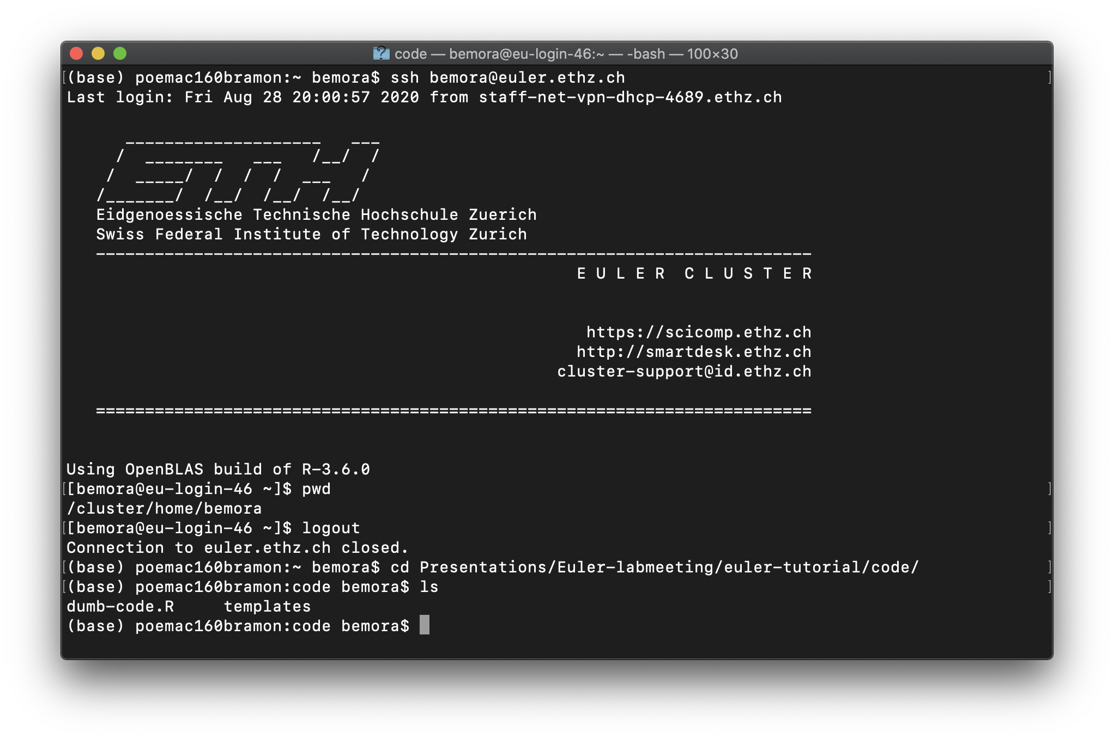
find your script…

Slide 27
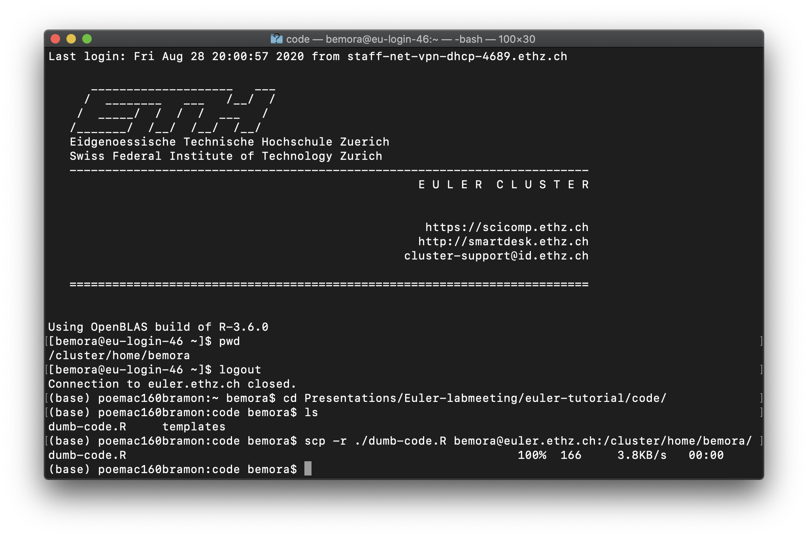
scp

Slide 28
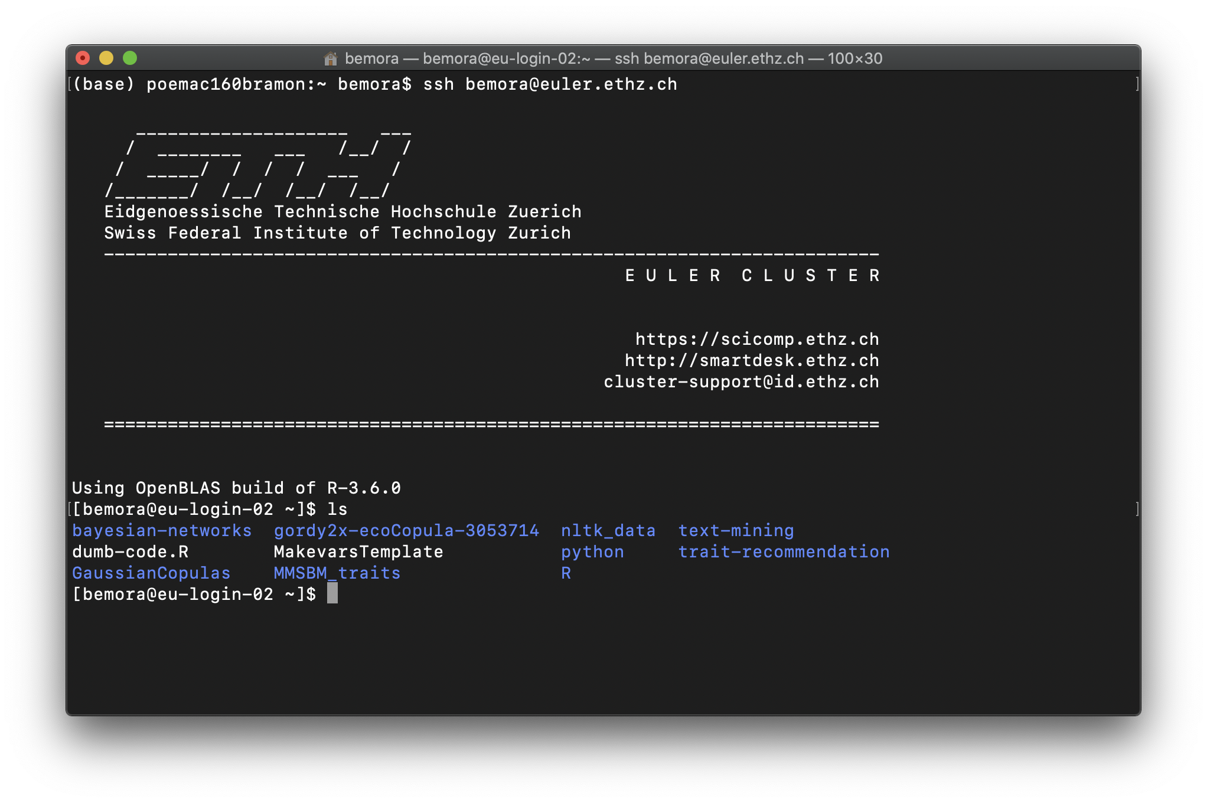
scp

Slide 29
scp

Slide 30
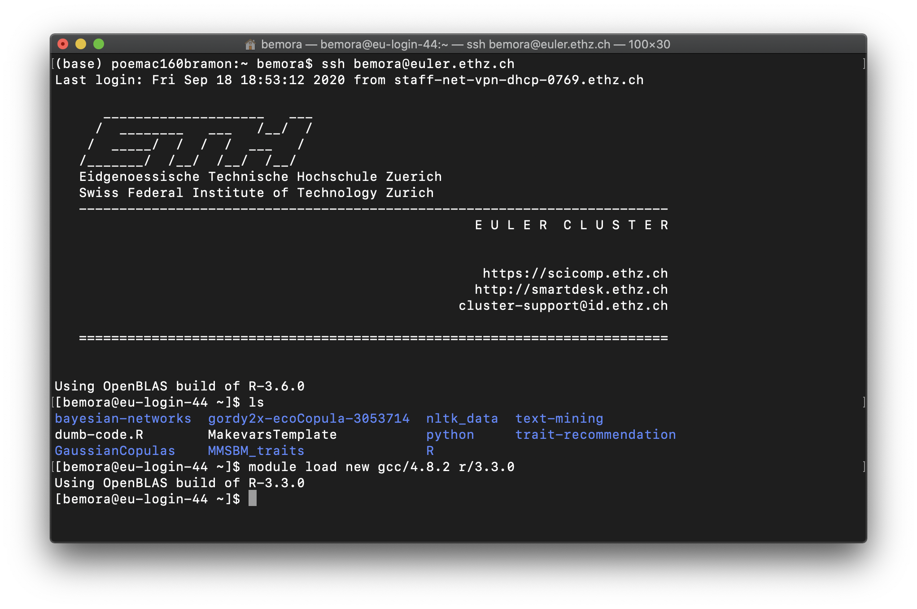
load R and compiler

Slide 31
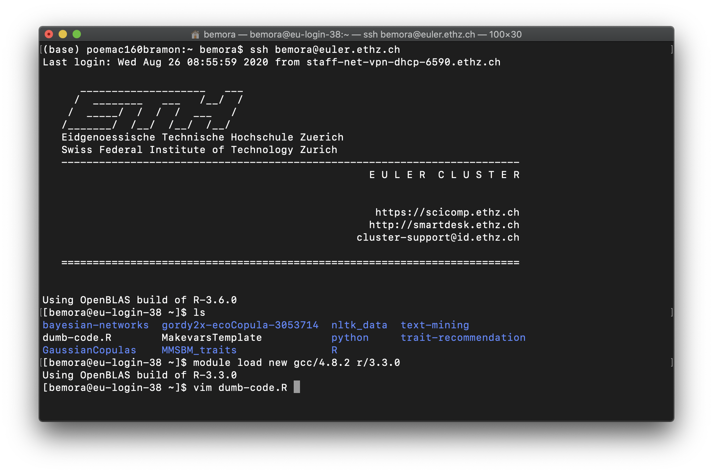
edit script

Slide 32
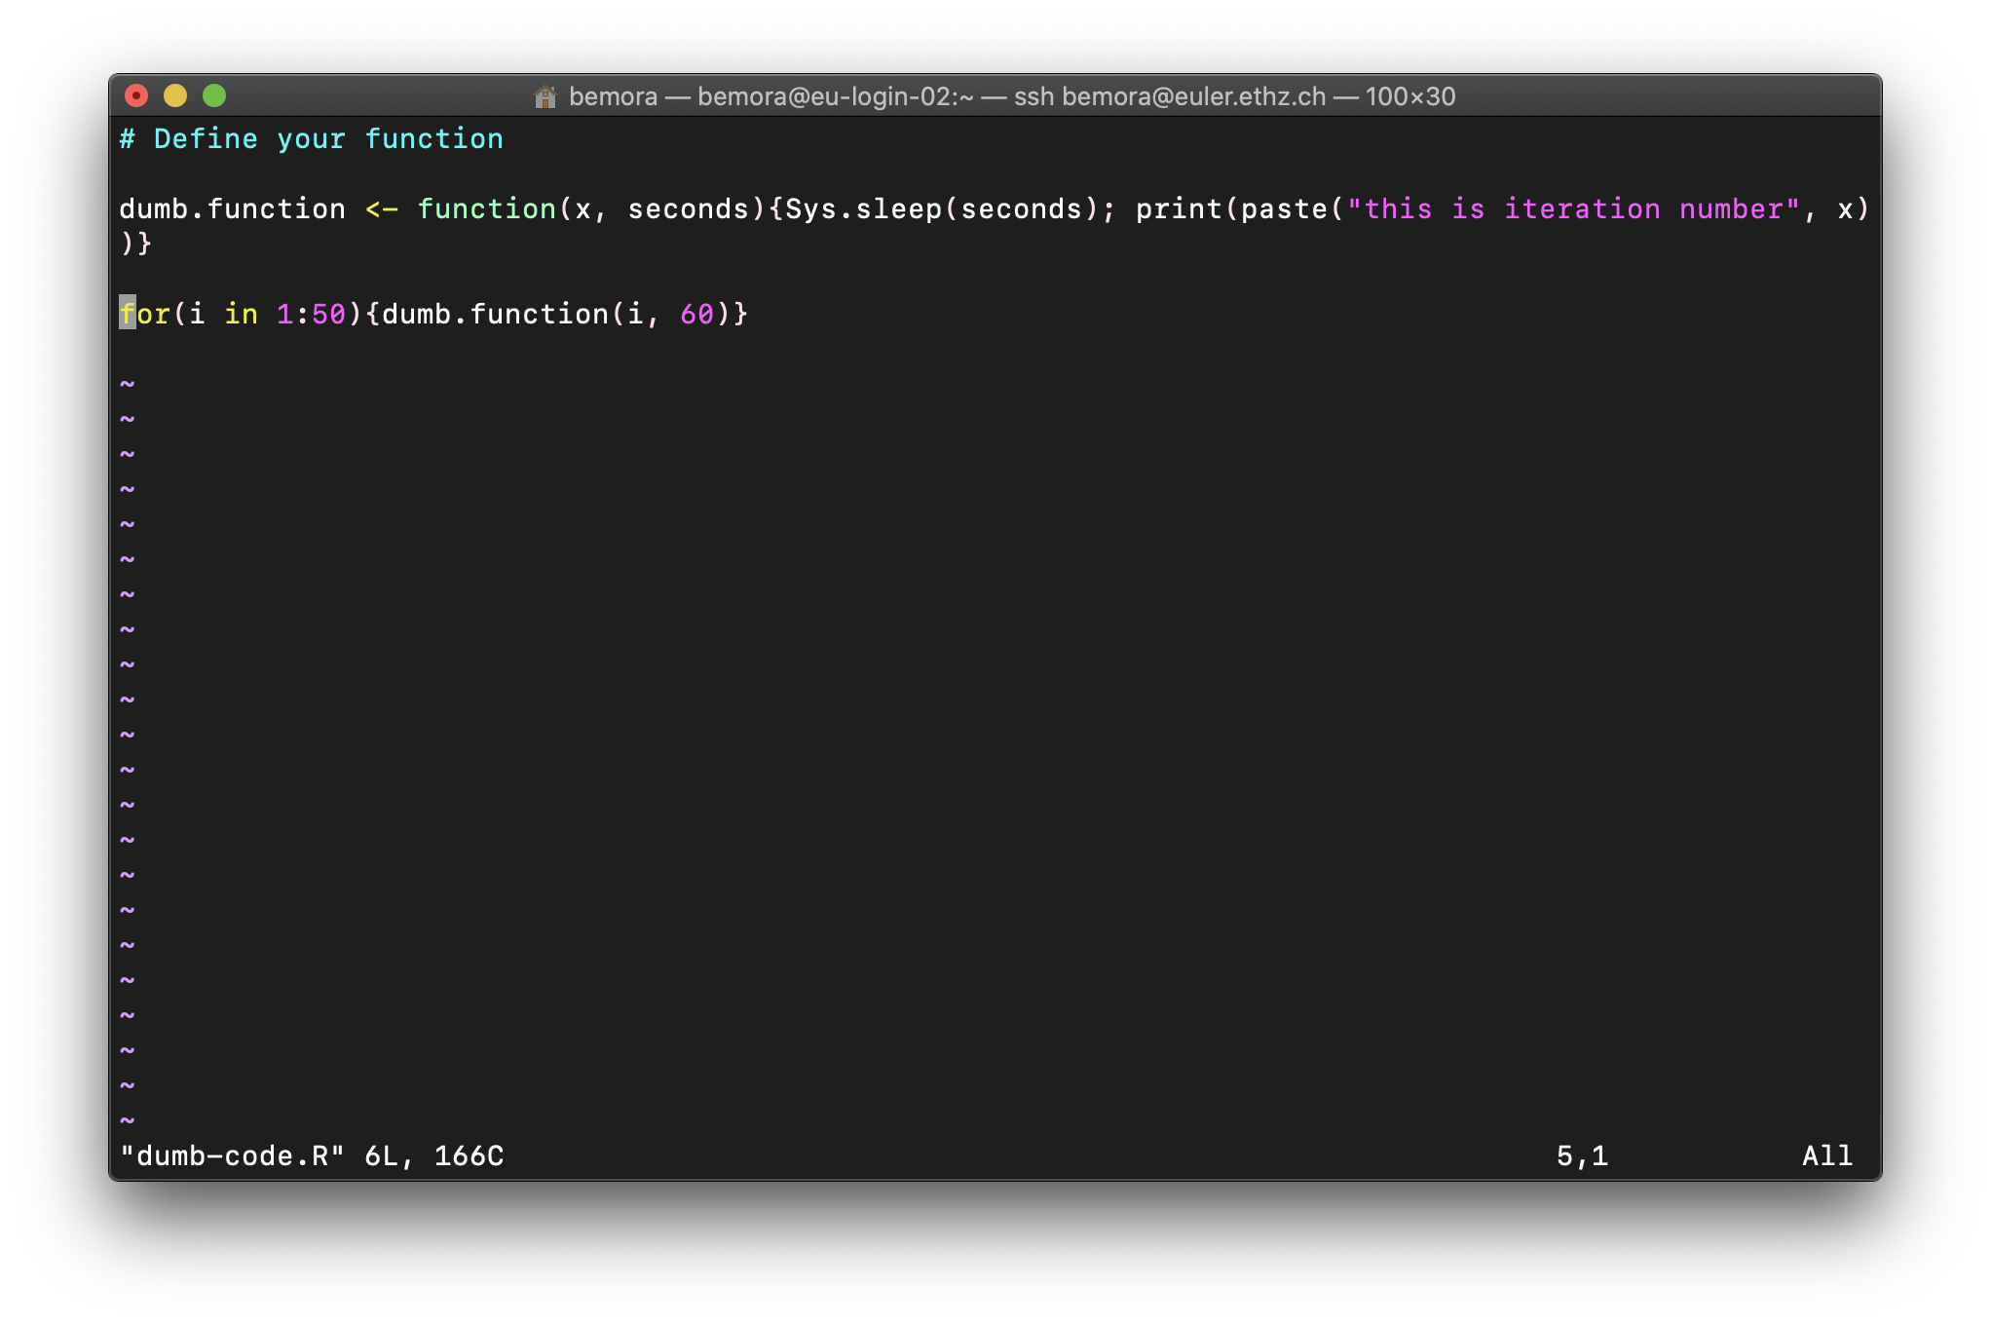
edit script

Slide 33
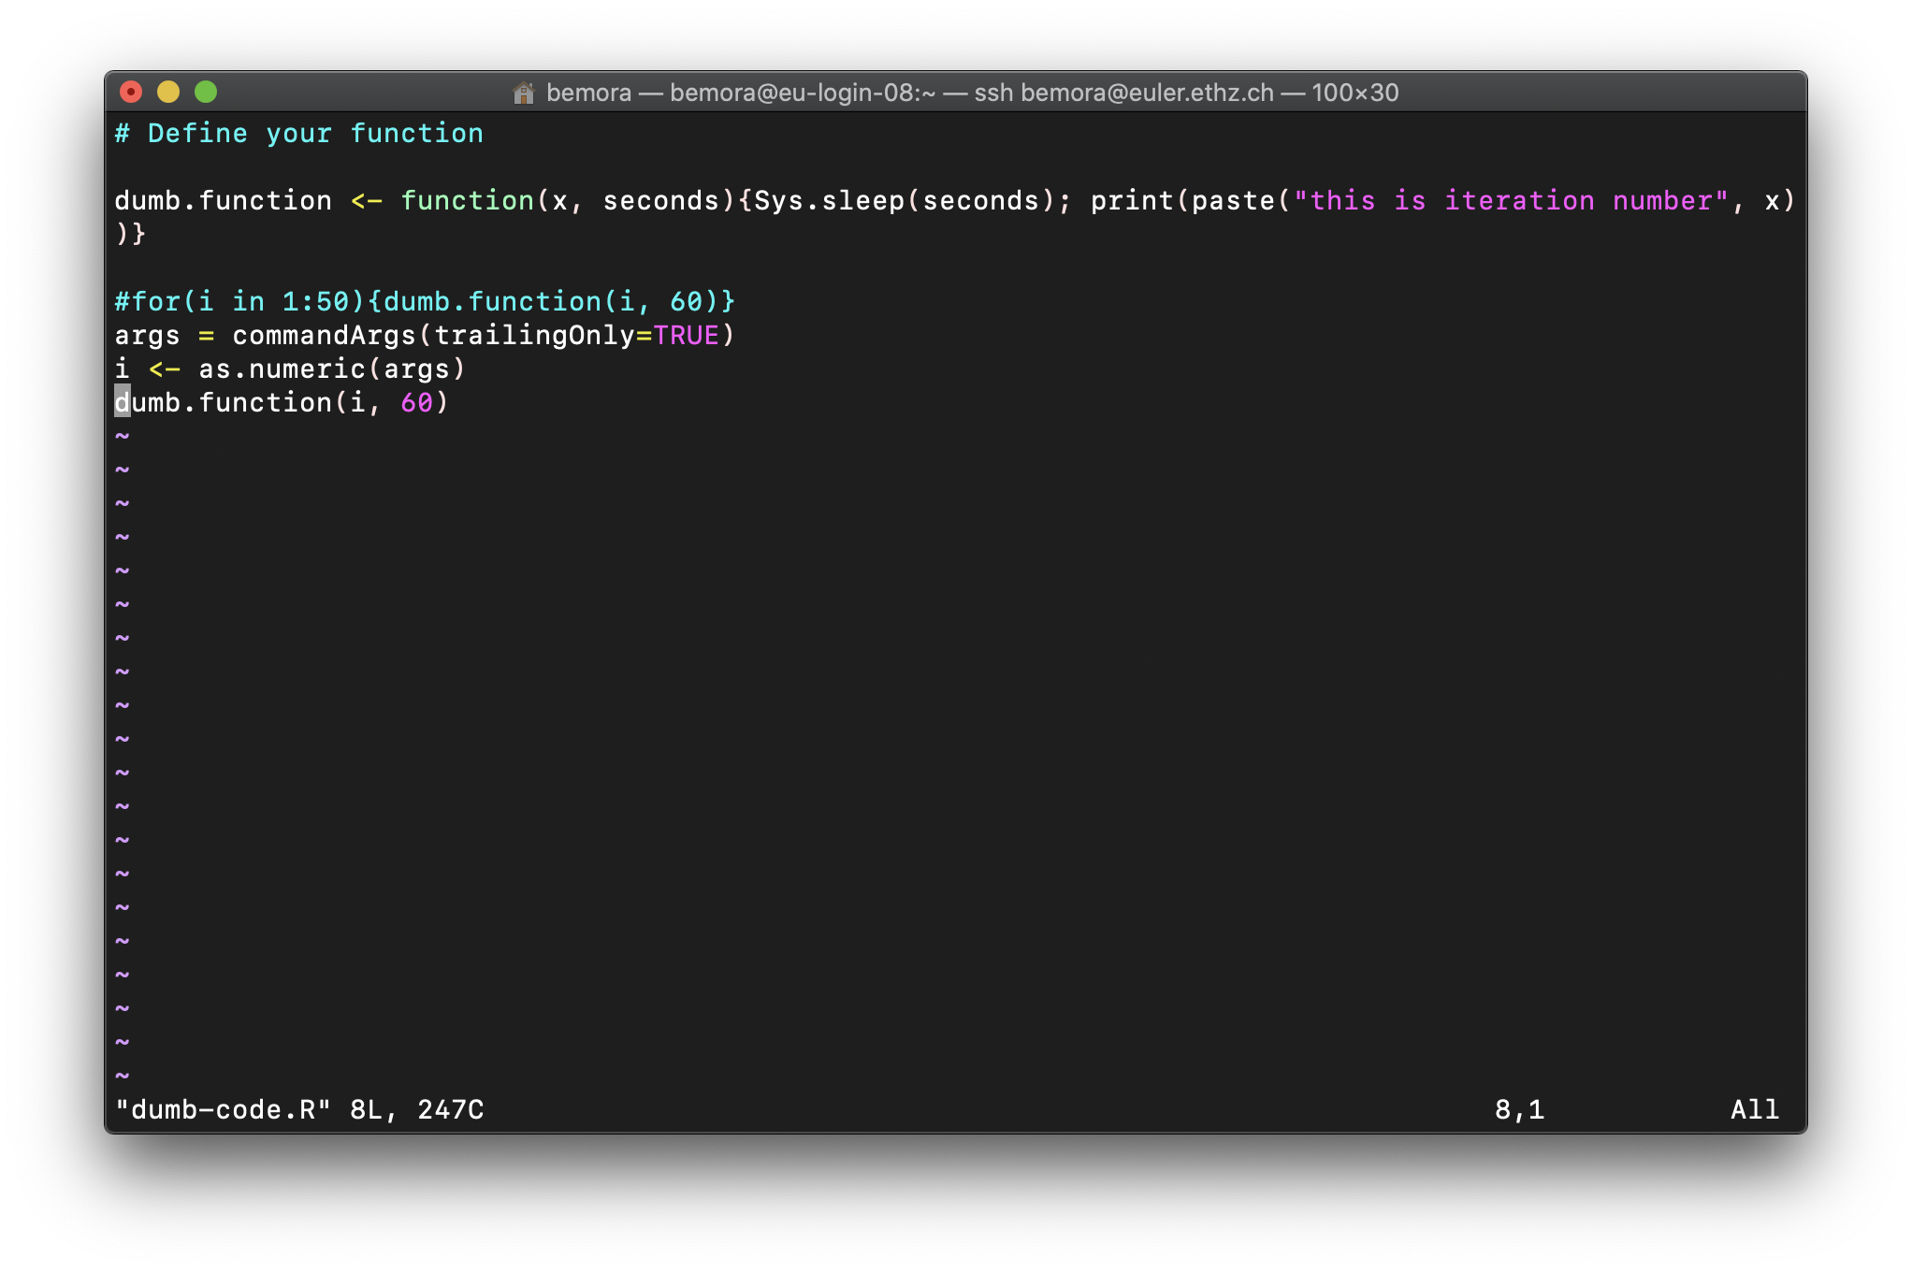
edit script

Slide 34
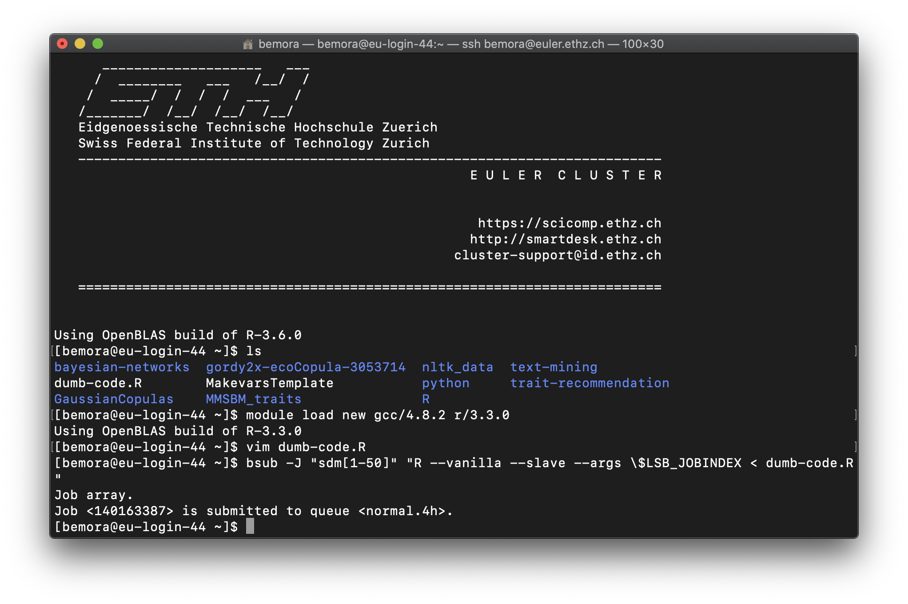
bsub

Slide 35
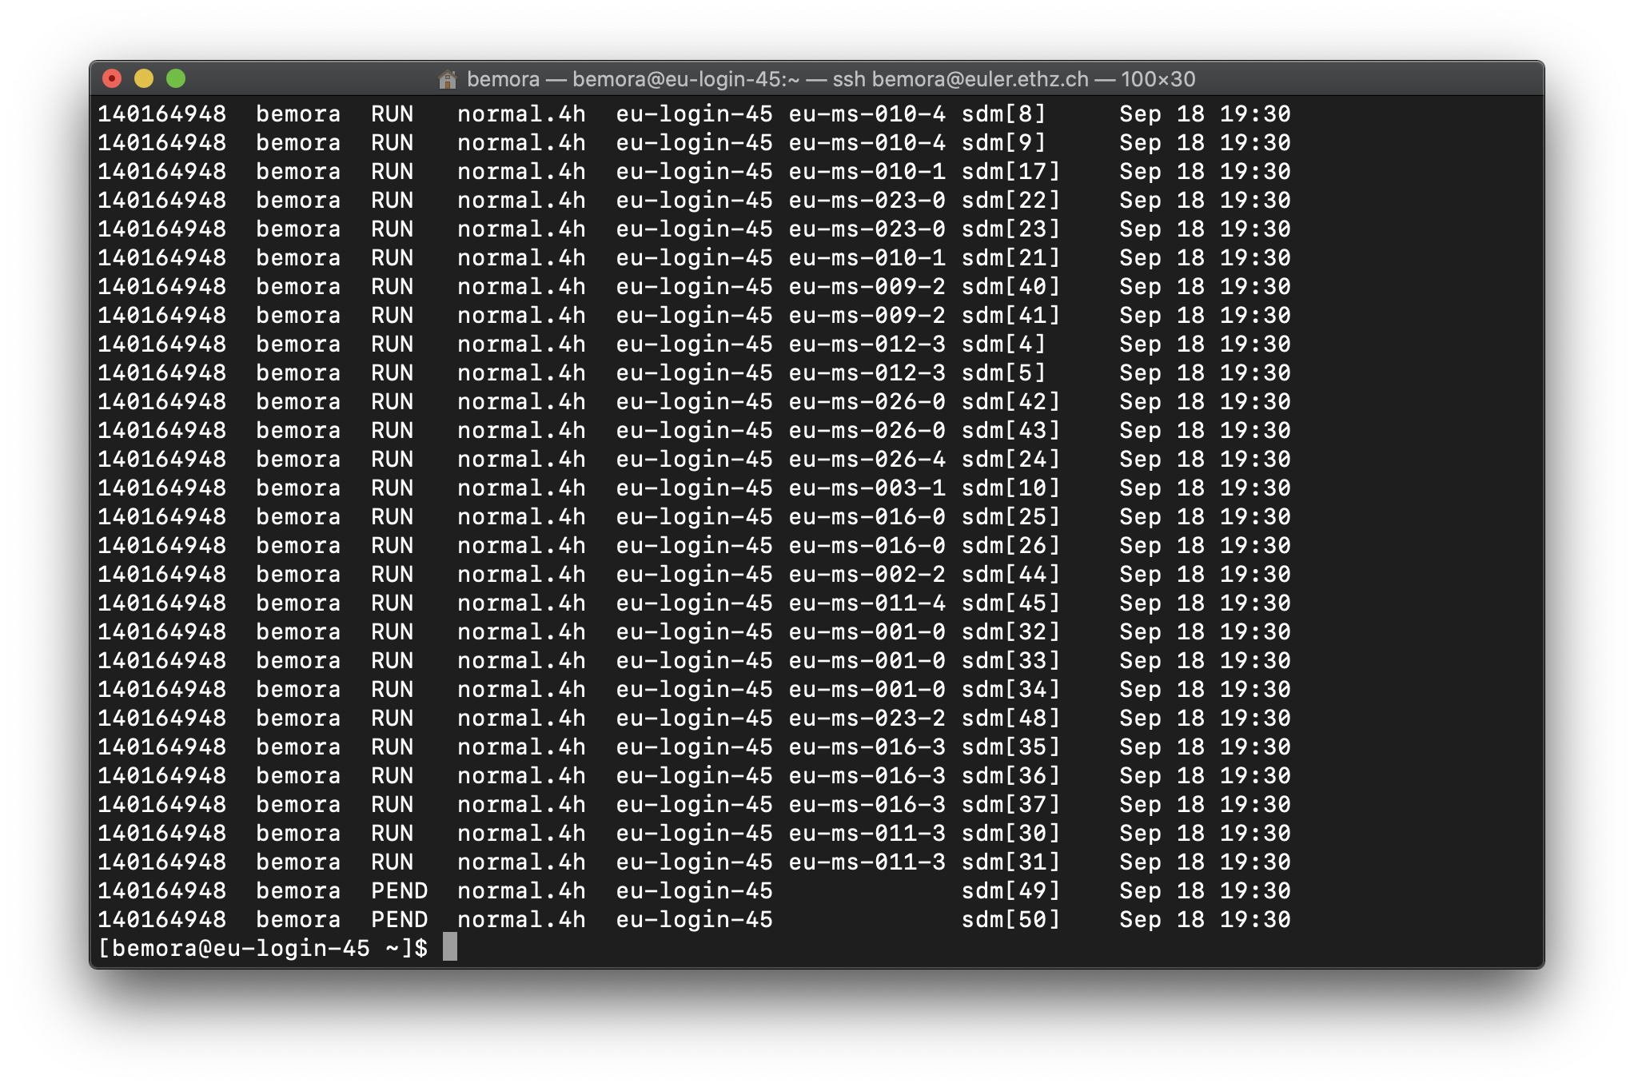
bjobs

